Slide 1
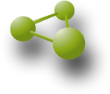
3DM for Diagnostics
Protein Superfamily Systems
& Pathogenicity predictions of
Human Gene Variants
Henk-Jan Joosten, Bio-Prodict

Slide 2
Variant effect predictions
Why is predicting pathogenicity so difficult?
Proteins are very complex molecules
There is a lack of (good, ready to go, integrated & validated) data
X-ray structures
High-quality multiple sequence alignments
Knowledge from literature
...

Slide 3
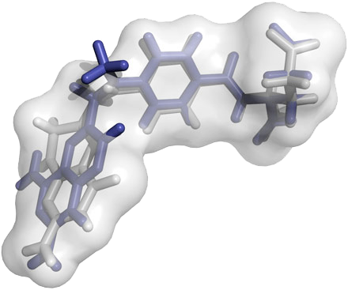
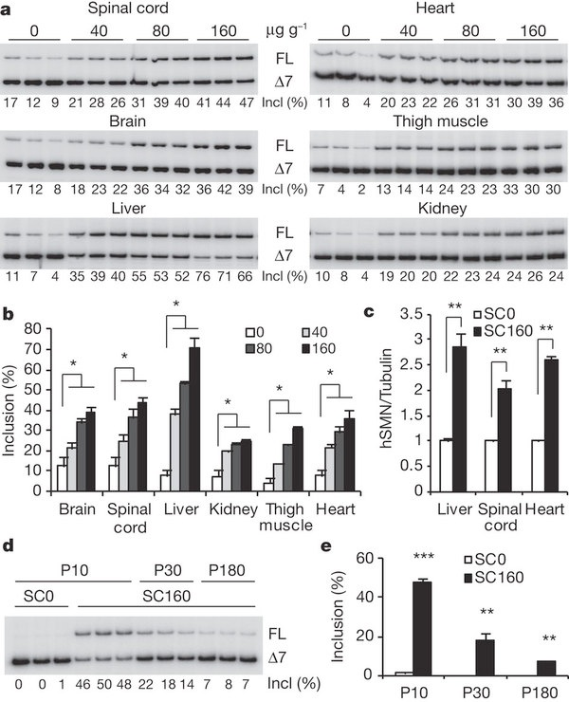
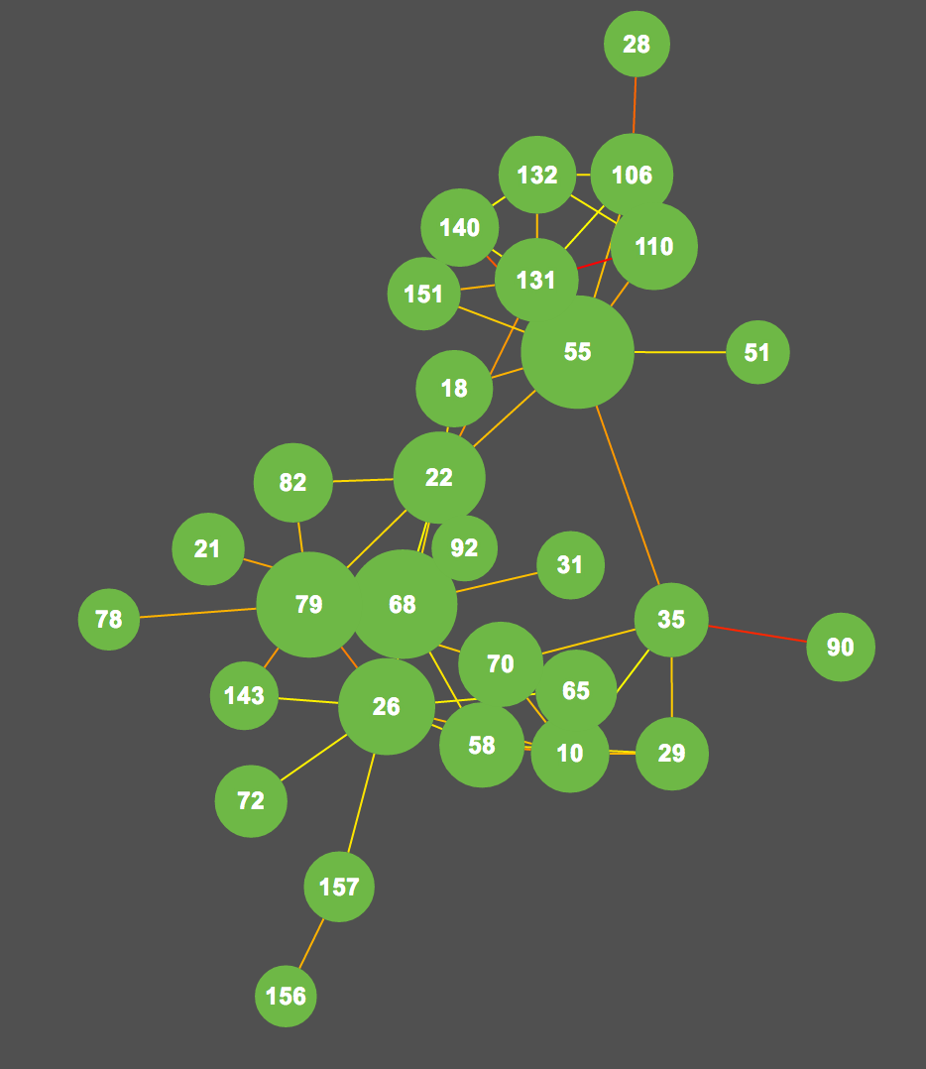
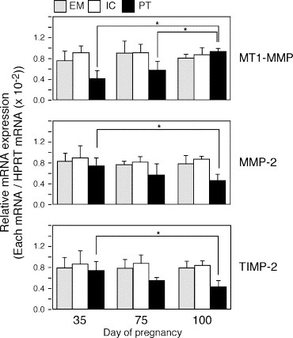
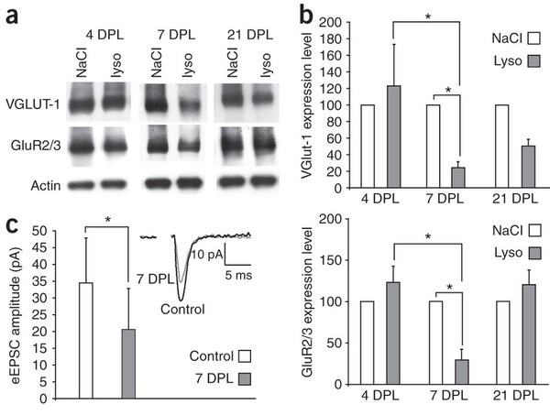
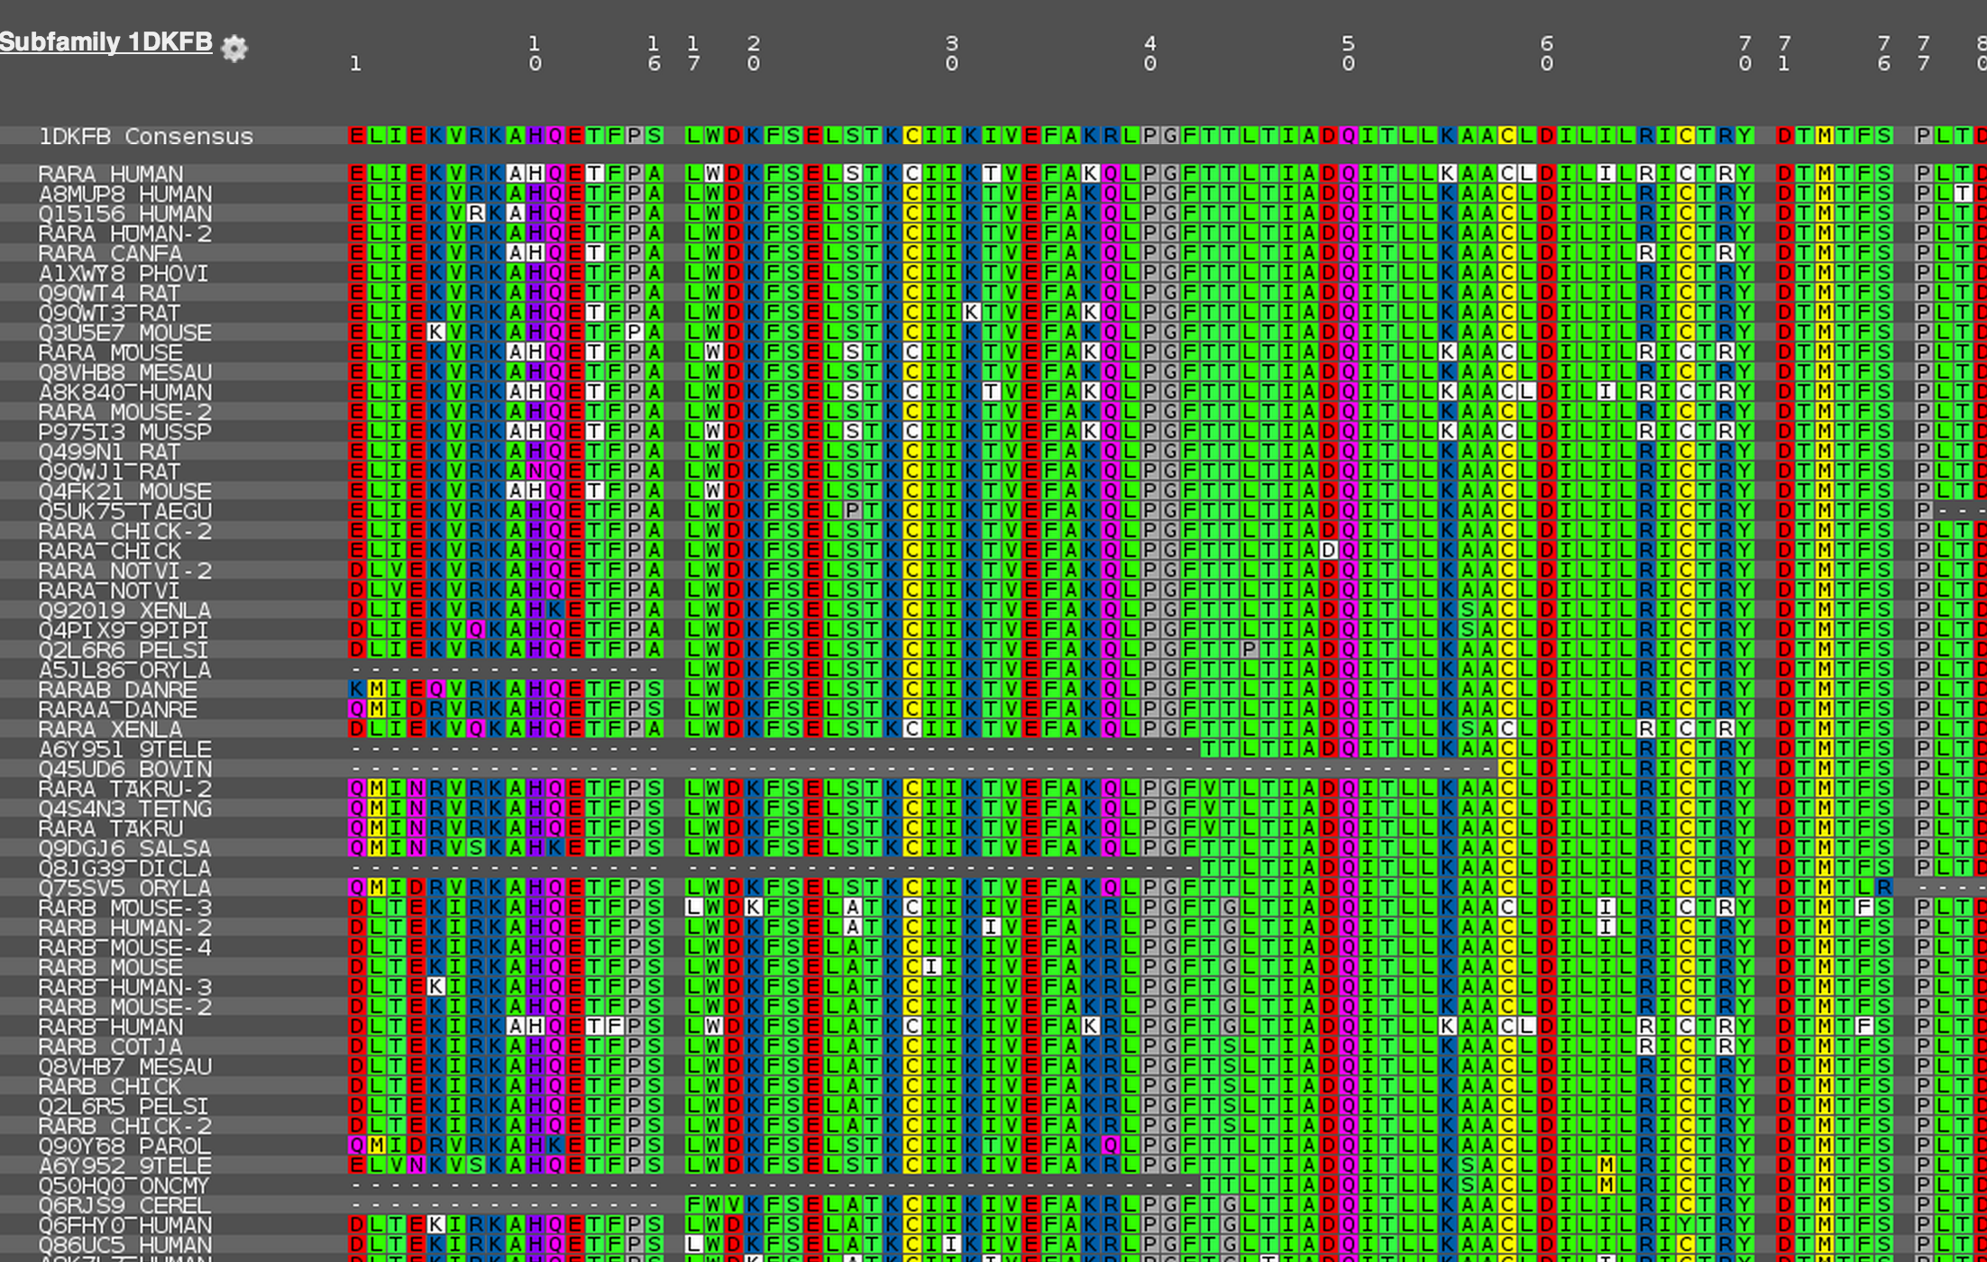
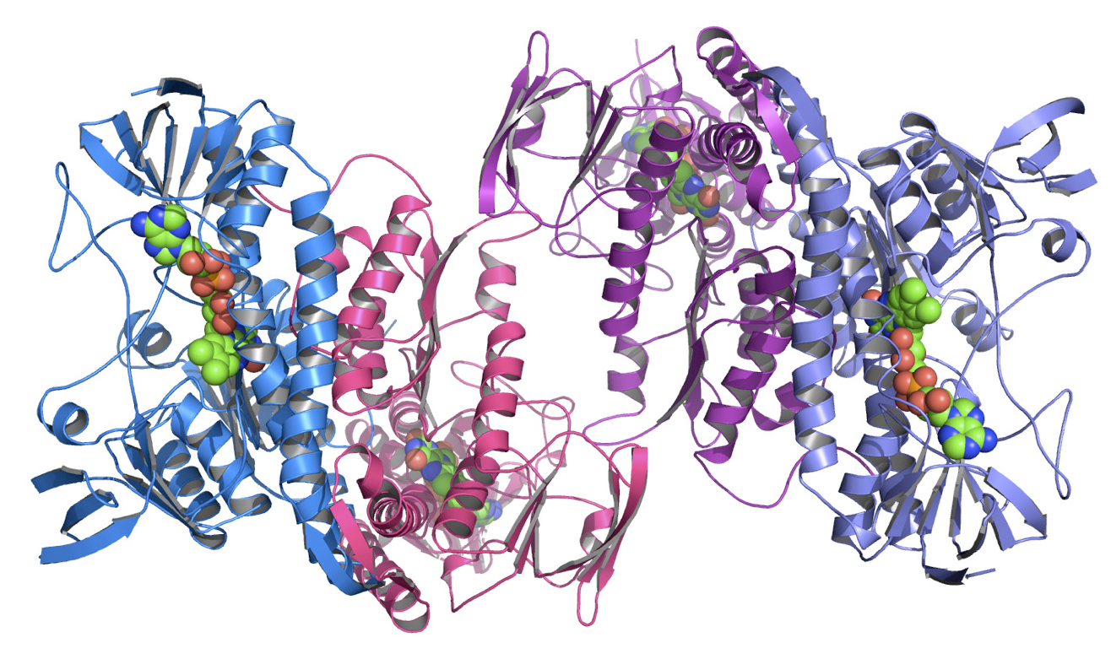
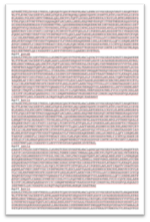
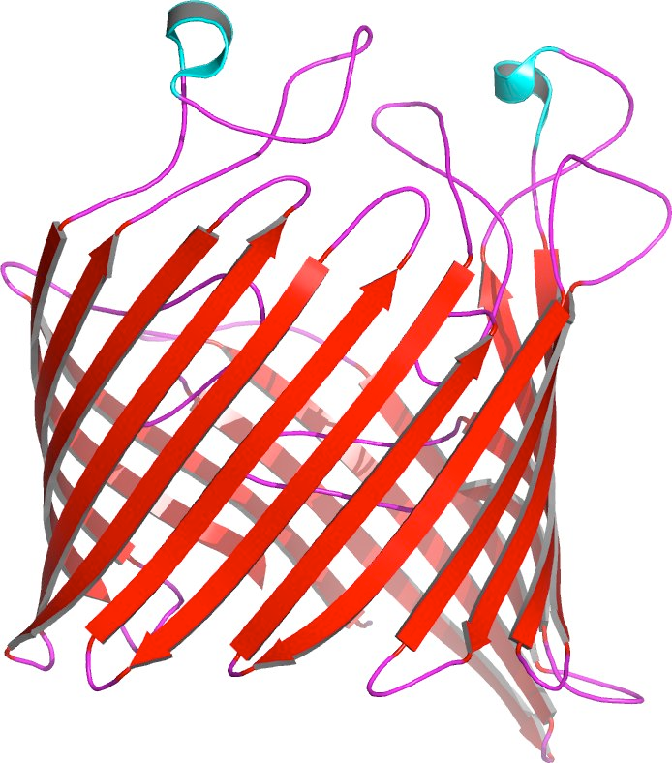
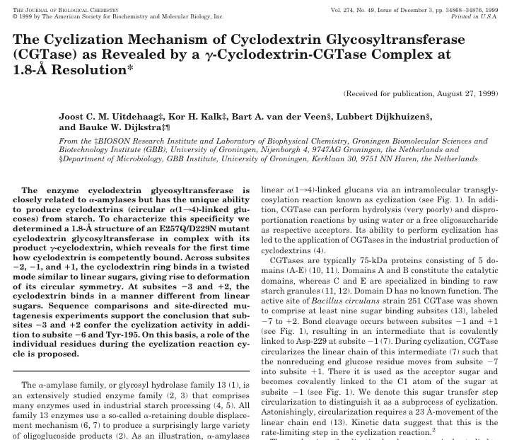
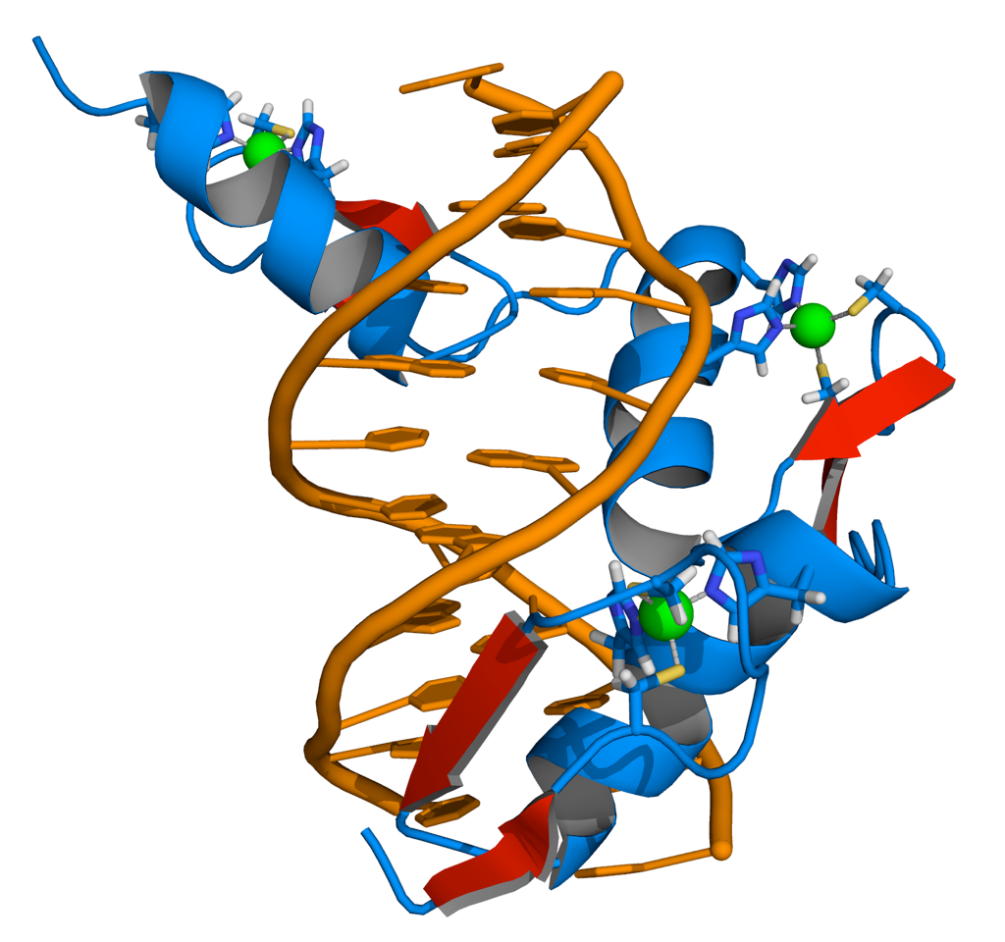
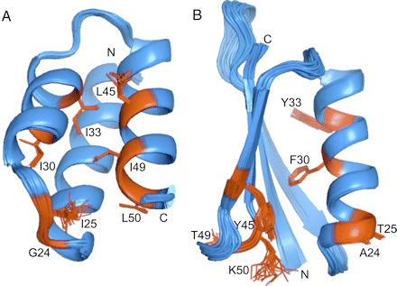
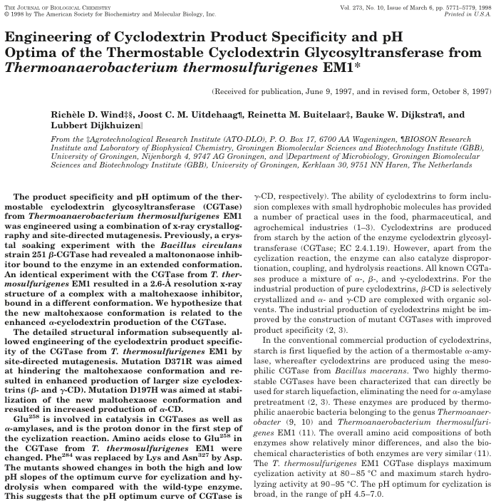
How to predict the effect of T877A in the Human AR
There is a HUGE amount of data available . . .
. . . from many different resources . . .
Notes:
This is a typical example of a question that researchers get:
Think about all the different data you would need to gather, integrate and validate to come up with some sensible answer:
Summarizing, already one pretty routine question leads to much work

Slide 4
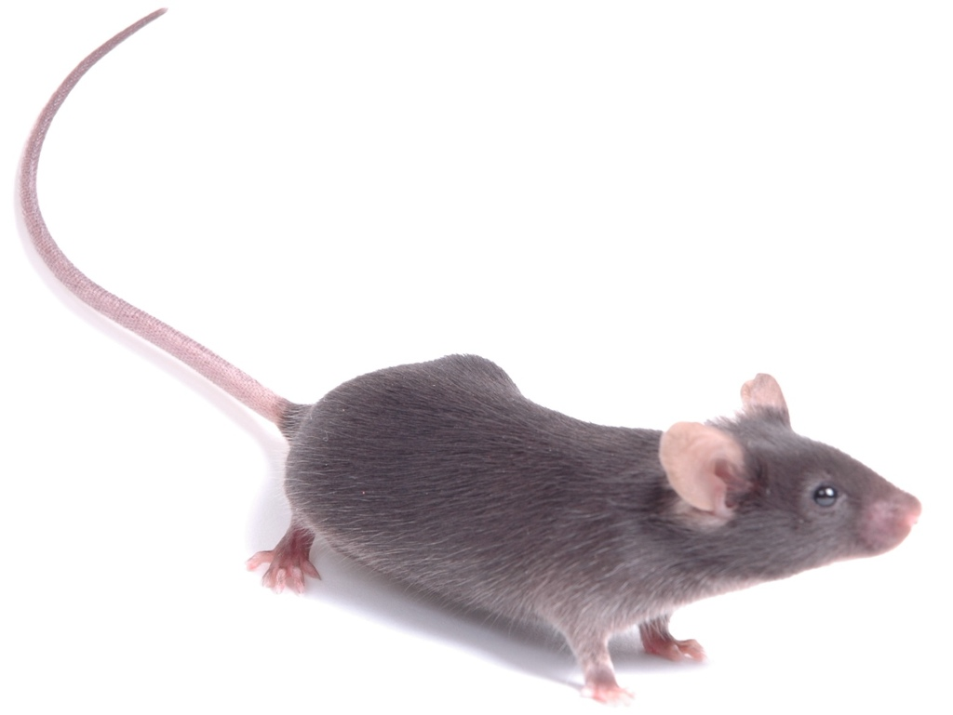
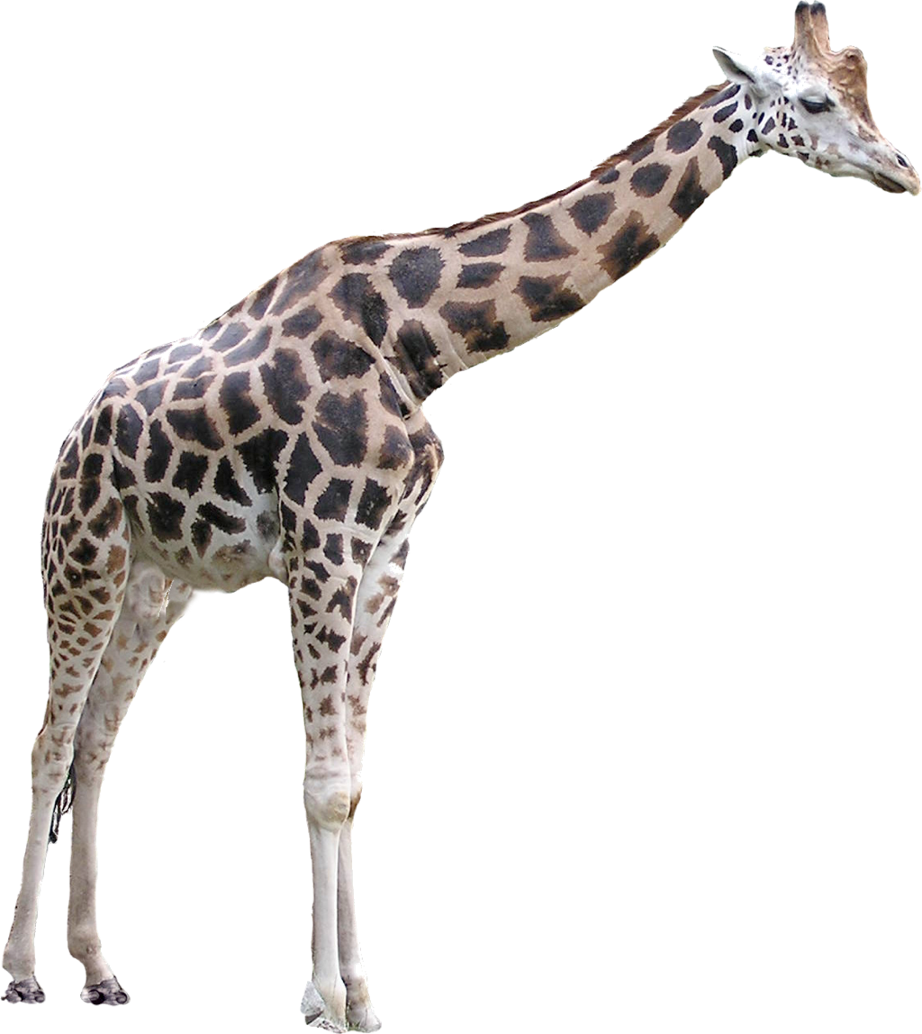
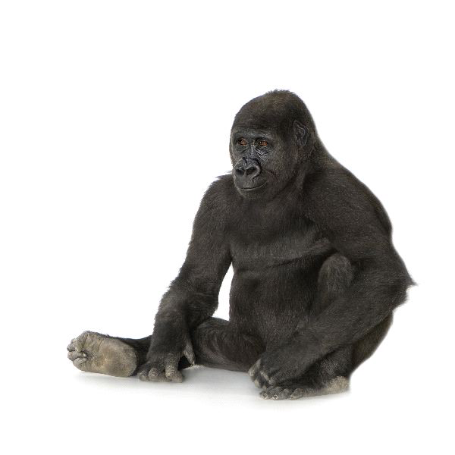
How to predict the effect of T877A in the Human AR
Mutation data - Literature, Swiss-Prot, OMIM, other mutation databases, …
SNPs - SNP databases, genome & exome sequencing projects, …
Alignment data - Conservation, amino acid type occurrences, …
Structural data - PPI, Ligand contacts, bridges, solvent accessibility, …
…
↻
Mutations at equivalent positions in homologous proteins often have the same effect:
Residue numbering problem!
Notes:
This is a typical example of a question that researchers get:
Think about all the different data you would need to gather, integrate and validate to come up with some sensible answer:
Summarizing, already one pretty routine question leads to much work

Slide 5
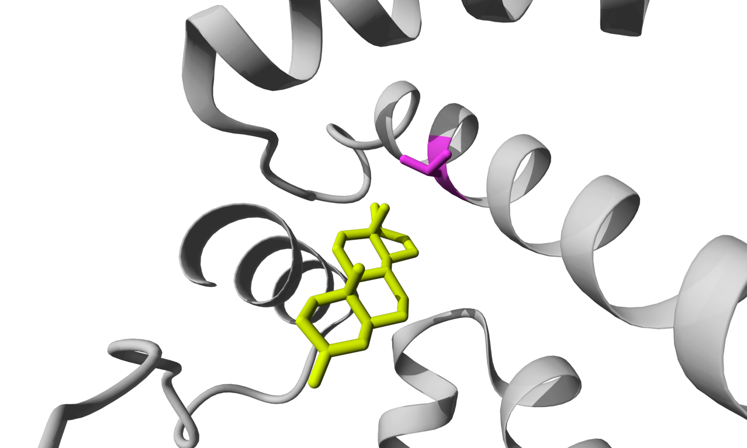
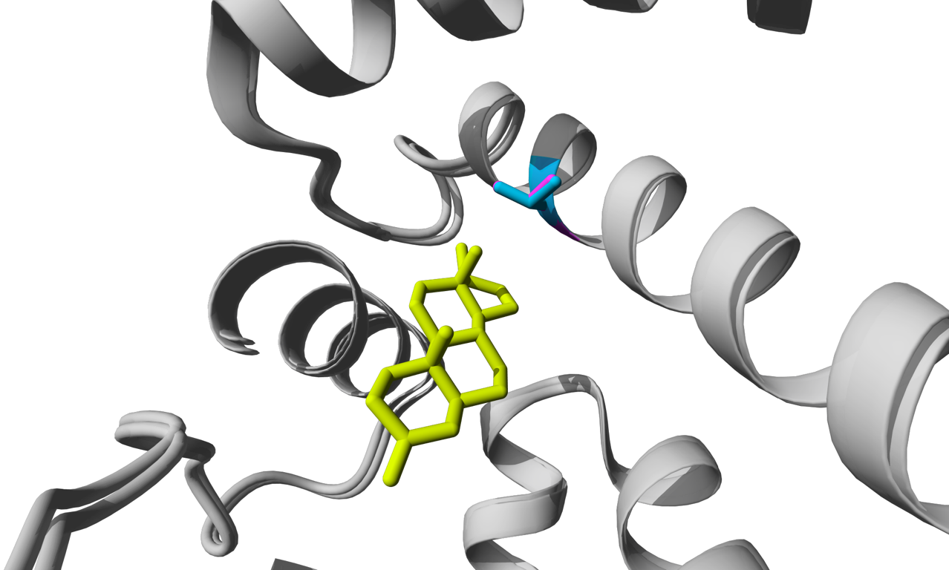
Mutations at equivalent positions often have the same effect
Human androgen receptor: T877
Mouse androgen receptor: T857
Because these residues are at the same position in the structure, it is likely they play the same role
We know that T857A causes prostate cancer in mice.
It is likely that T877A in humans also cause prostate cancer
Notes:
This is a typical example of a question that researchers get:
Think about all the different data you would need to gather, integrate and validate to come up with some sensible answer:
Summarizing, already one pretty routine question leads to much work

Slide 6
3DM
A platform that automatically collects, stores, connects, and visualises many different data types for a complete protein superfamily and applies a unified numbering scheme to the sequences and structures enabling data transfer between the proteins.

Slide 7
Data integration
3DM stores many different data extracted from various sources
Sequences
Structures
Literature
Alignments
Variants
Correlated mutation
Ligand contact data
And many more . . .
For a complete superfamily: - different protein functions
- many different species
Notes:
This is a typical example of a question that researchers get:
Think about all the different data you would need to gather, integrate and validate to come up with some sensible answer:
Summarizing, already one pretty routine question leads to much work

Slide 8
Data integration
From alignment to structure What are the most conserved positions in the family multiple sequence alignment?
Positions colored orange are > 85% conserved in an alignment of ~5000 nuclear receptor proteins
Notes:
This is a typical example of a question that researchers get:
Think about all the different data you would need to gather, integrate and validate to come up with some sensible answer:
Summarizing, already one pretty routine question leads to much work

Slide 9
Data integration
From literature to structure What are the most frequently mutated positions in the literature?
For each purple position there are at least 150 papers discussing a mutation at that position
Notes:
This is a typical example of a question that researchers get:
Think about all the different data you would need to gather, integrate and validate to come up with some sensible answer:
Summarizing, already one pretty routine question leads to much work

Slide 10
Data integration
From literature to structure Which positions are related to Prostate Cancer?
For each pink position there are at least 30 papers discussing a mutation at that position together with “Prostate Cancer”
Notes:
This is a typical example of a question that researchers get:
Think about all the different data you would need to gather, integrate and validate to come up with some sensible answer:
Summarizing, already one pretty routine question leads to much work

Slide 11
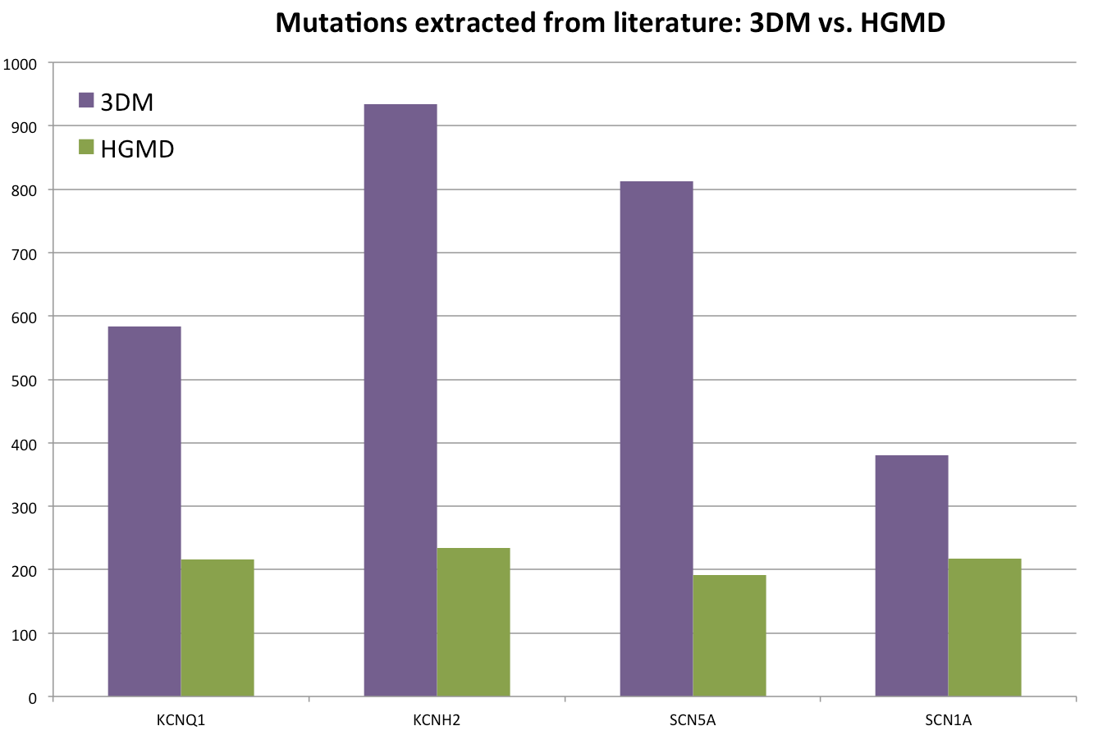
3DM automatically extracts mutation data from literature
Notes:
This is a typical example of a question that researchers get:
Think about all the different data you would need to gather, integrate and validate to come up with some sensible answer:
Summarizing, already one pretty routine question leads to much work

Slide 12
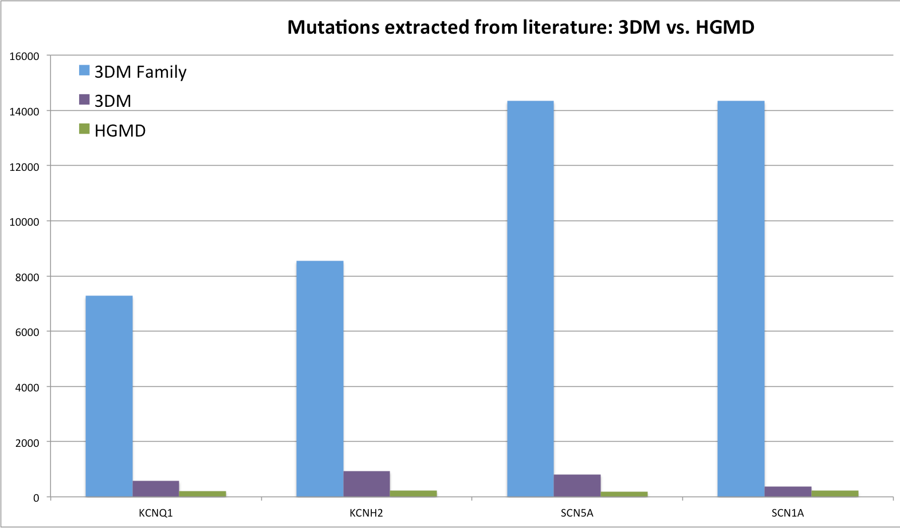
3DM automatically extracts mutation data from literature

Slide 13
3DM
Massive data integration to enable data transfer
between proteins between data types
to learn from it
and to predict!
Now that we have all this integrated data, can we use it to predict the effects of variants?

Slide 14
Building the predictive model
Input
High-quality case and control groups
Parameters that might be indicative of the variant being pathogenic or benign
Notes:
So, how did we go about building such a model? The first thing we need is a golden set, a set of variants for which we actually know wether they are benign or pathogenic.
Second, we need a set of parameters for each variant that might be indicative
Then, using logistic regression analysis, we can optimize the weights of the individual parameters. Then, when we have a good idea of how the model is performing, a suitable cutoff point can be set.
The output of these steps is a model that, if all parameter values are supplied, can classify any new variant as being either pathogenic or benign.

Slide 15
3DM variant effect predictions
Long QT syndrome
966 patients with variants in KCNH2, KCNQ1 or SCN5A, with accurate associated variant impacts
750 cases (pathogenic variant)
216 controls (benign variant)

Slide 16
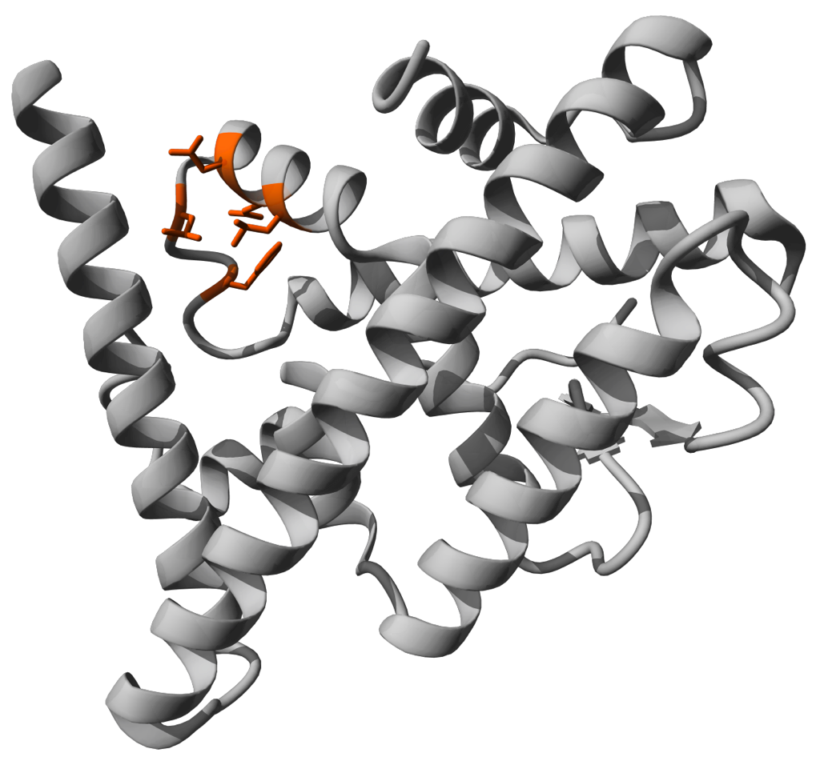
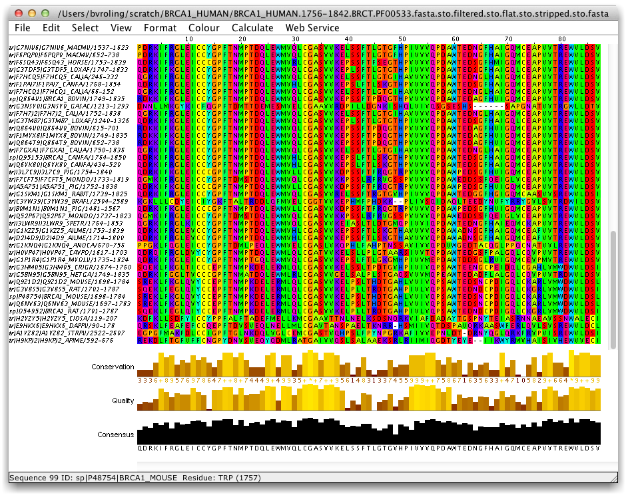
3DM mutation effect predictions
30 parameters for each variant generated with 3DM
conservation in alignment
hydrophobicity
position in core or in variable region?
transmembrane domain or water-soluble?
Is the variant detected in homologs?
Binds the residue to a ligand?
Form it a salt- or cysteine bridge?
Is it a correlated mutation?
Does the variant fit in the structure?
Sticks the residue inside the protein?
. . .
Cases & controls
Parameter values
Gene | Variant | Classification | Hydrophobicity | Core | Conservation | ...
KCNH2 | S641F | Case | -4 | Core | 0,87 | ...
KCNH2 | D1037N | Control | -5 | Variable | 0,21 | ...
SCN5A | V232I | Case | 3 | Variable | 0,72 | ...
... | ... | ... | ... | ... | ... | ...

Slide 17
Building the predictive model
Machine learning
Make test and training sets;
Determine the relative importance (weight) of each parameter using the training set
Make predictions on the test set.
Repeat this until the model doesn’t predict better >1M times.
Use the model on novel variants of known effect
Notes:
So, how did we go about building such a model? The first thing we need is a golden set, a set of variants for which we actually know wether they are benign or pathogenic.
Second, we need a set of parameters for each variant that might be indicative
Then, using logistic regression analysis, we can optimize the weights of the individual parameters. Then, when we have a good idea of how the model is performing, a suitable cutoff point can be set.
The output of these steps is a model that, if all parameter values are supplied, can classify any new variant as being either pathogenic or benign.

Slide 18
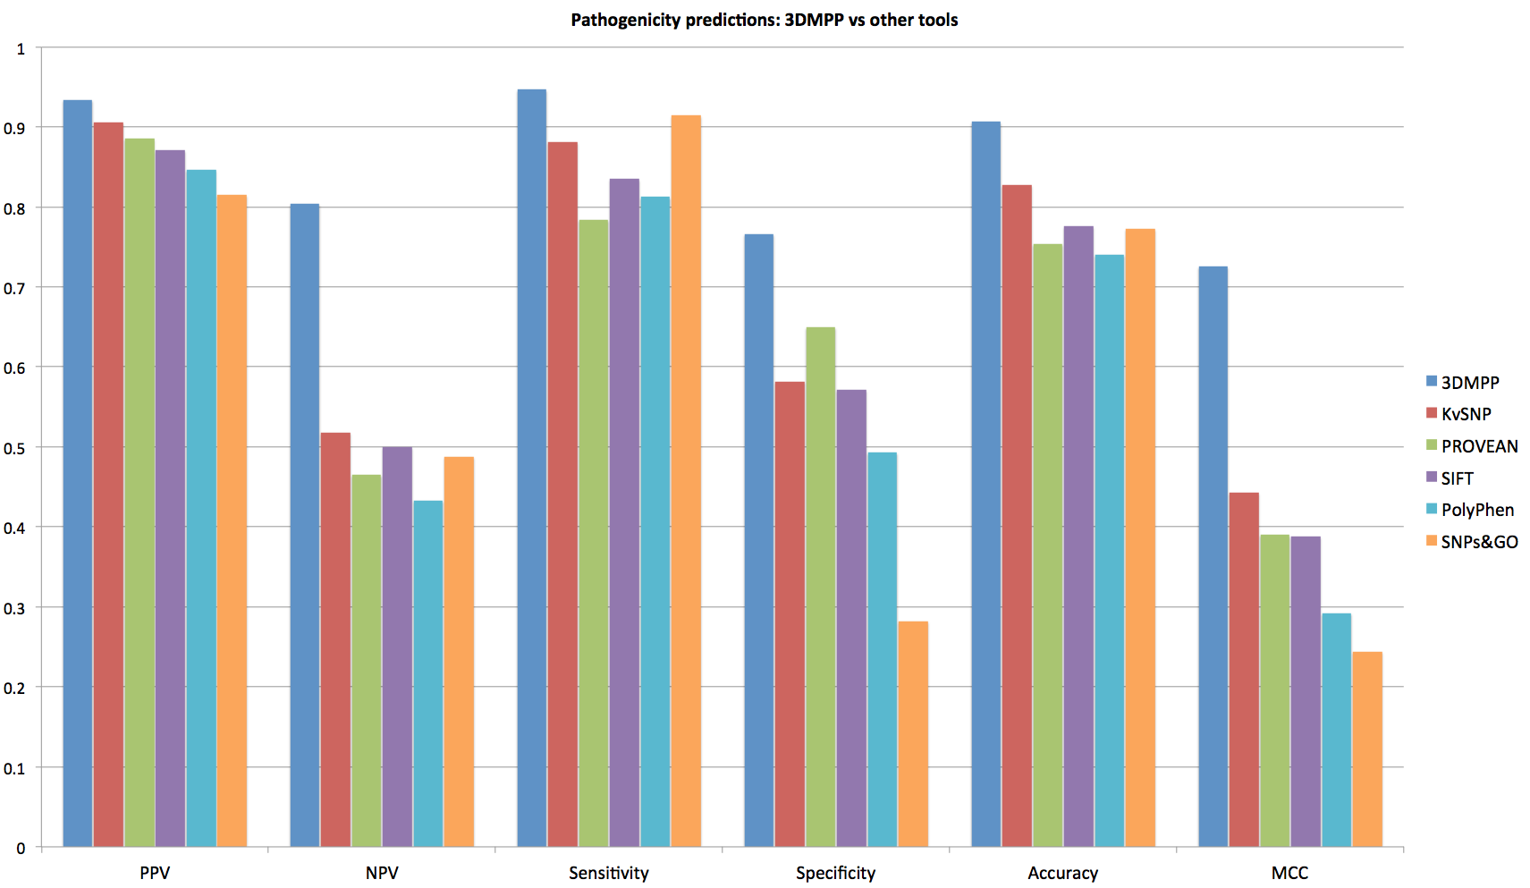
3DM variant effect predictions
PPV: if a variant is classified as pathogenic, it has a Y% chance of actually being pathogenic
NPV: if a variant is classified as benign, it has a Y% chance of actually being benign
Sensitivity: Y% of all pathogenic variants are classified as such
Specificity: Y% of all benign variants are classified as such

Slide 19
3DM variant effect predictions
PPV: if a variant is classified as pathogenic, it has a Y% chance of actually being pathogenic
NPV: if a variant is classified as benign, it has a Y% chance of actually being benign
Sensitivity: Y% of all pathogenic variants are classified as such
Specificity: Y% of all benign variants are classified as such
MCC (Matthews correlation coefficient ): widely used method for determining the overall performance

Slide 20
https://diagnostics.bio-prodict.nl
for DNA diagnostics
LQT systems:
- SCN5A
- KCNQ1
- KCNH2

Slide 21
Conclusions
3DM protein superfamily analysis systems contain many different predictive data types
These can by used to predict effects of mutations by applying machine learning algorithmes
The resulting models perform much better than the available tools.

